Slide 1
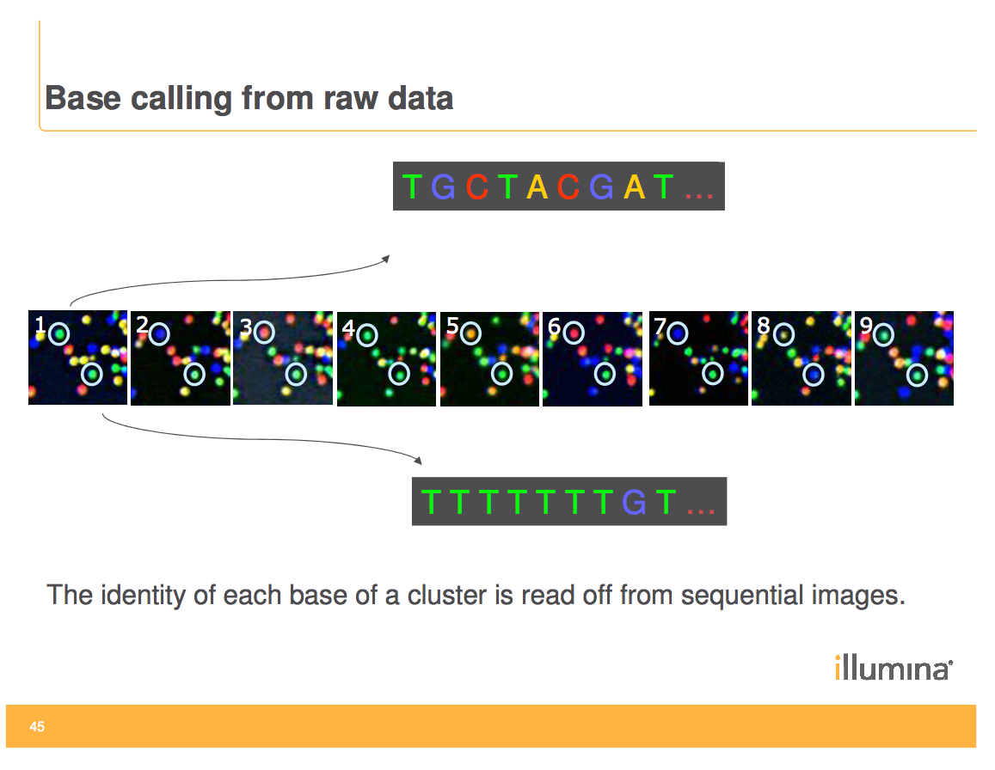

Slide 2
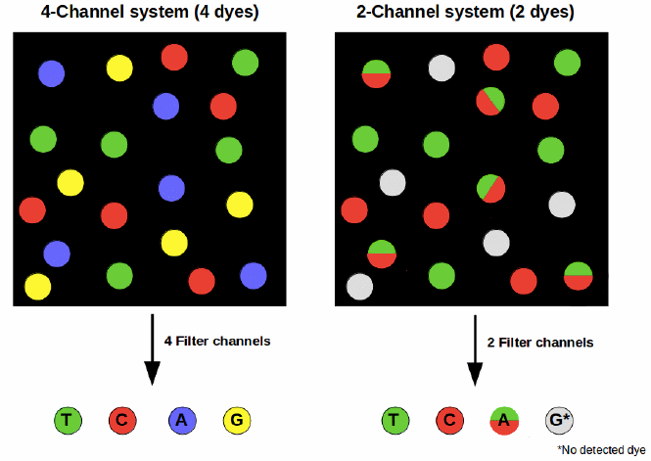
4 channel vs 2 channel detection
2 channel detection can cause sequencing errors due to phasing issues
and can cause polyG tracts at the end of fragments
MiSeq, HiSeq 4000 and X
MiniSeq, NextSeq, NovaSeq

Slide 3
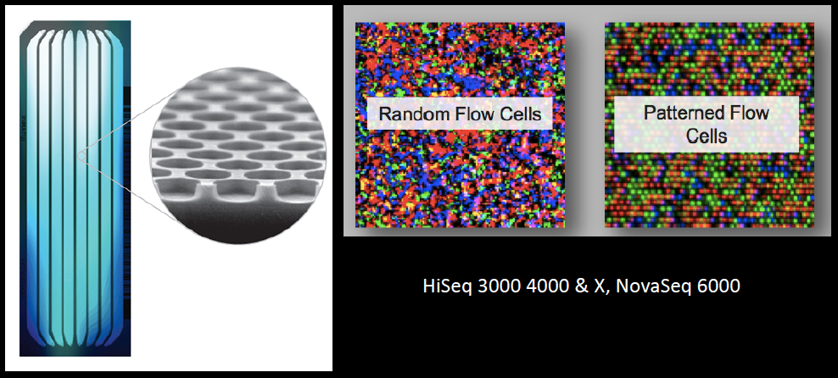
Patterned flow cells
Improves regularity of densities and qualities
Reduces analysis time

Slide 4
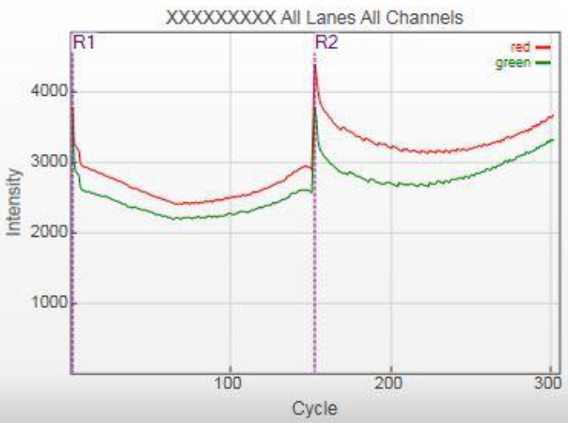
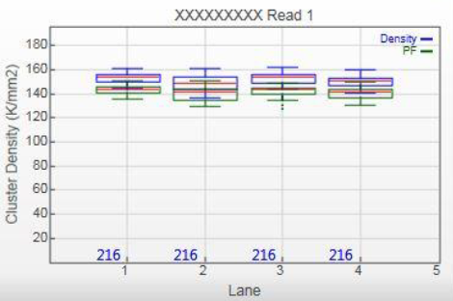
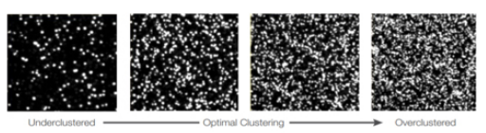
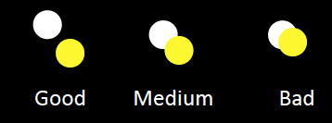
Sequencing qualities
Intensities
Cluster densities
Intensity values of the four incorporated bases are measured to determine if a clustering failure has occurred
Density of clusters for each tile in thousands/mm². Overloading of the library may cause merging of clusters, lowering of the % PF and reduction of the quality score (Q30)
Percentage of reads passing filter (% PF)
Reflects the purity of the signal from each cluster. Ratio of the brightest intensity divided by the sum of the brightest and second brightest intensities for each cycle. Optimal values for MiSeq and HiSeq 2500 from 80-95%.
Underclustered Overclustered

Slide 5
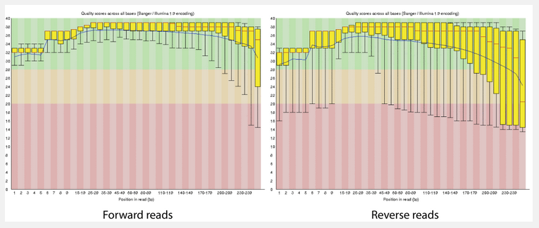
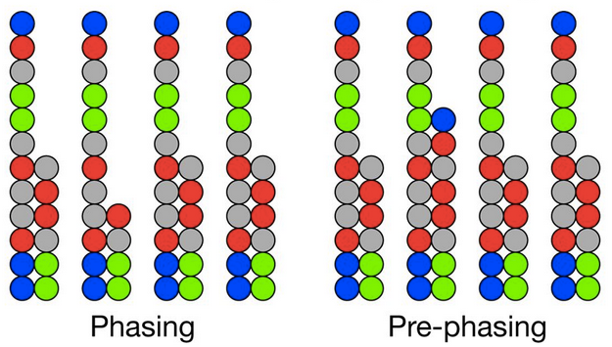
Sequencing qualities
Phasing/Prephasing
Q-score
Percentages of bases that fell behind or jumped ahead the current cycle within a read. It increases with cycle number, hampering correct base identification for long reads. Optimal values are below 0.5 or 0.2% depending on platform. Issues may arise when read length is above specifications.
Base calling error probabilities P : Q = − 10 log₁₀ P
% Q-score > 30 : percentage of bases that have a a probability of incorrect base calling of 1/1000. Low Q scores can increase false-positive variant calls, which can result in inaccurate conclusions.

Slide 6
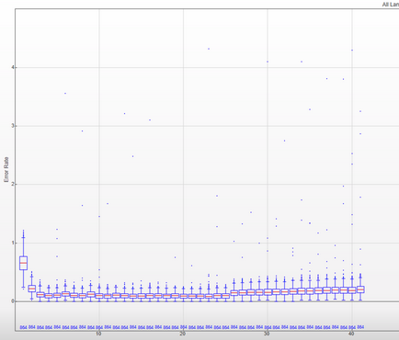
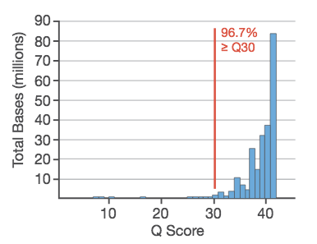
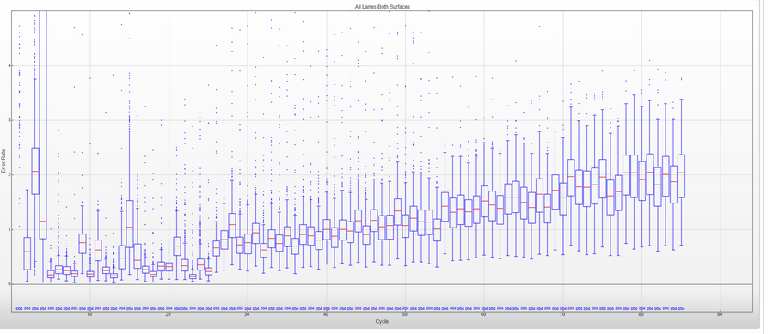
Sequencing qualities
Percentage of alignment
Error rate
% align: percentage of the reads aligned to PhiX control genome. It is important to estimate the error rate. Indication on the success of the clustering process.
Calculated for each read based on the aligned % of PhiX control sample. Important to determine if the sequencing has proceeded as expected.
Error rate ≈ 0.1 %
“bad” sequencing

Slide 7
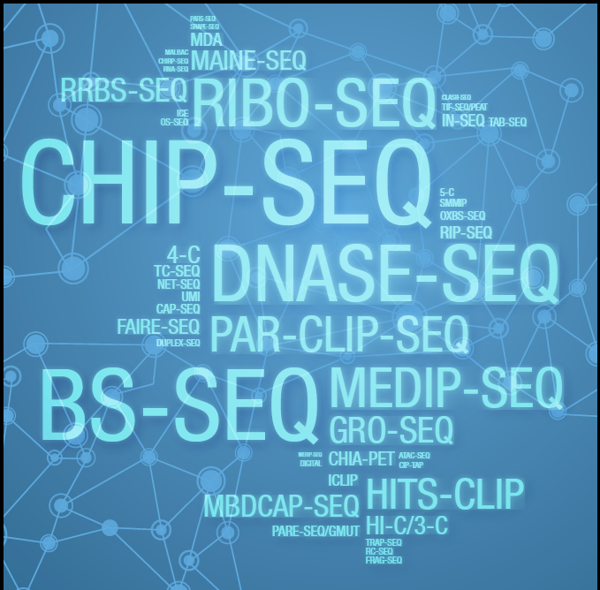
Many applications

Slide 8
SINGLE CELL TECHNOLOGIES
Single cell transcriptomics allows to study transcriptome heterogeneity,
to investigate differences in transcript expression and gene regulation in individual cells :
Differences in trancript abundance
Alternative splicing and differential expression of isoforms
Most widely used device to study single-cell transcriptomics : Chromium controller (10x Genomics)
Several applications :
Single cell Gene expression
Measures gene activity on a cell-by-cell basis, characterize cell populations, cell types, …
Linked read genomics
Performs diploid de novo assembly, phase haplotypes, genetic variations
Single cell ATAC
Measures epigenetics by detecting open chromatin regions

Slide 9
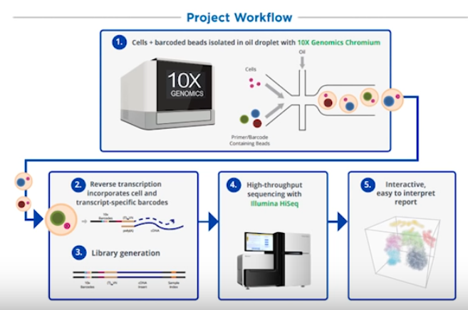

Slide 10
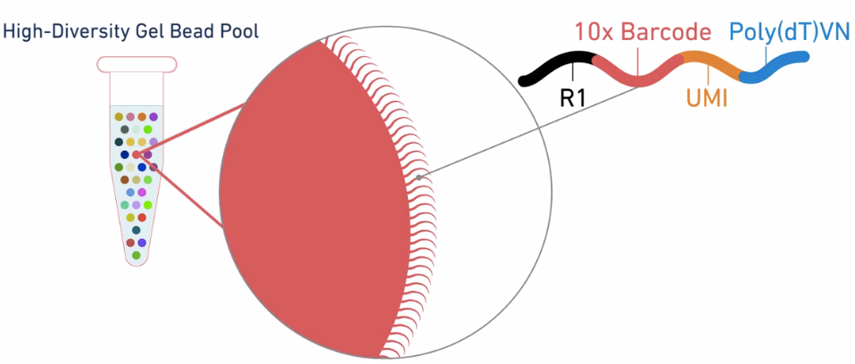
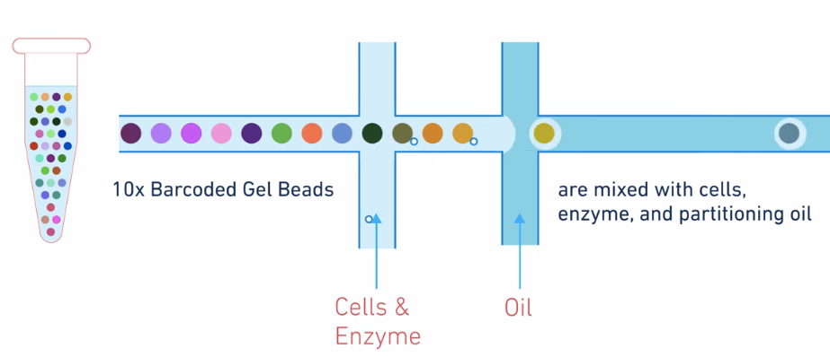
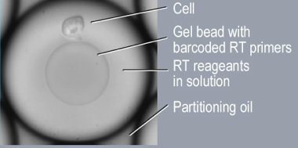
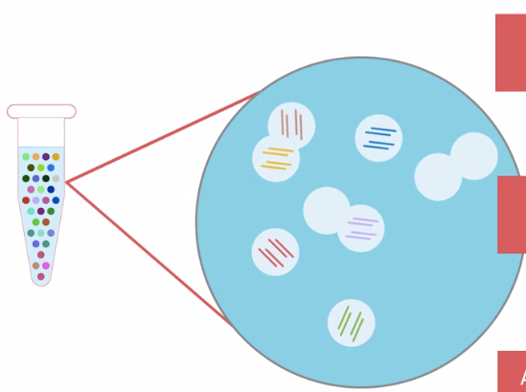
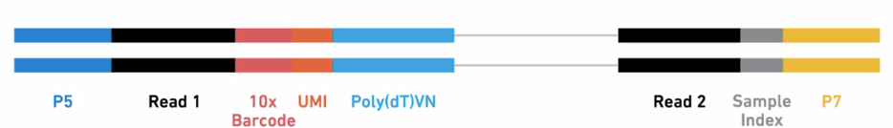
CHROMIUM SINGLE-CELL RNA SEQUENCING
5’
3’
barcodes separately index
each cell’s transcriptome
Single cells undergo RT
All cDNAs from one cell
share the same barcode
barcoded sequencing library

Slide 11
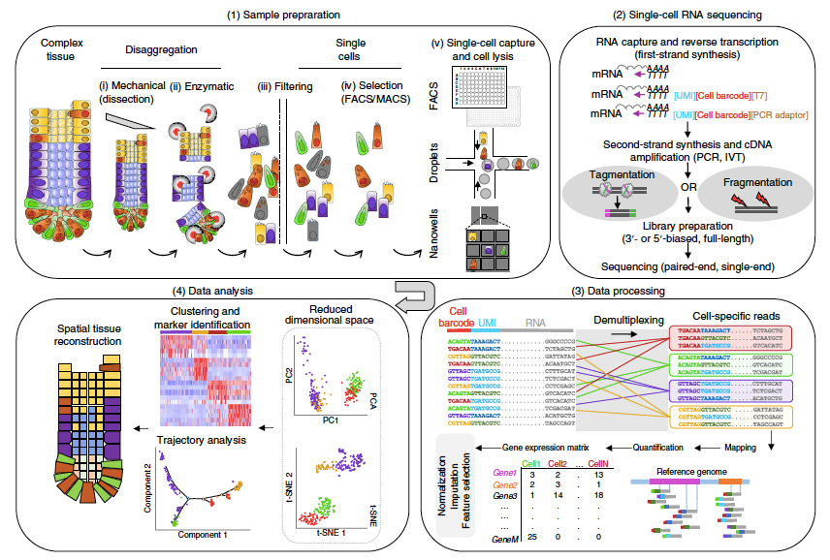
CHROMIUM SINGLE-CELL RNA SEQUENCING
DATA ANALYSES
CELL RANGER :
Chromium data
analysis pipelines

Slide 12
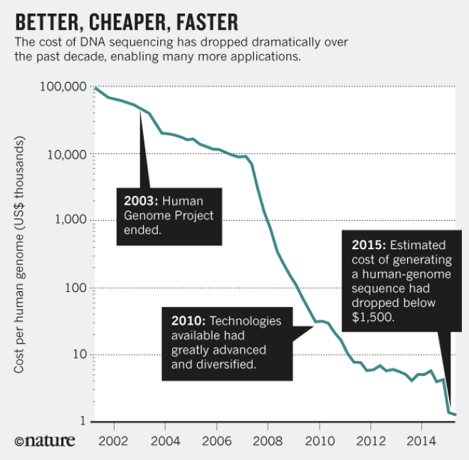

Slide 13

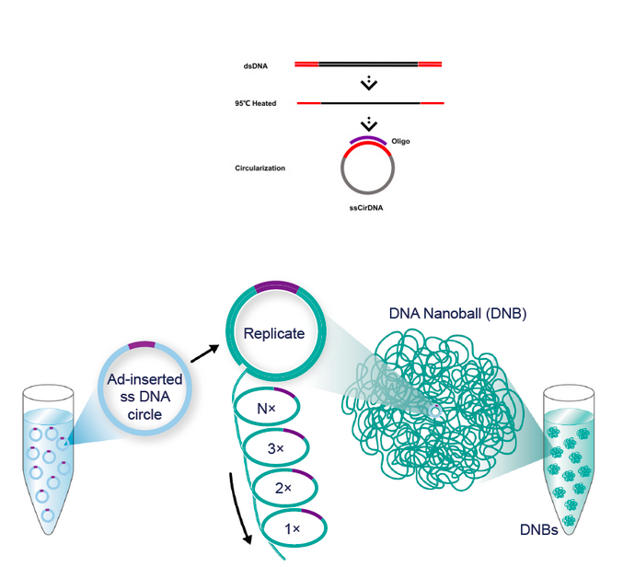
NEW SEQUENCING TECHNOLOGY
acquisition of U.S. company Complete Genomics in 2013

Slide 14
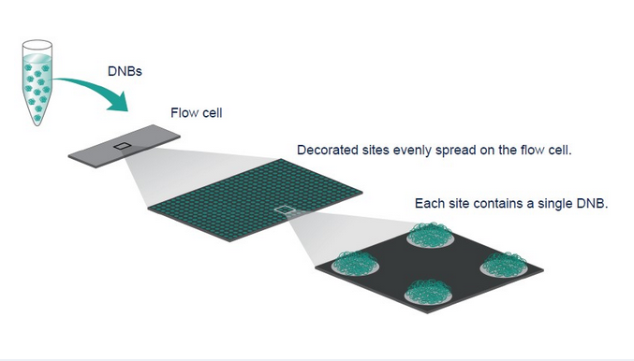
NEW SEQUENCING TECHNOLOGY

Slide 15
PART 2
3rd GENERATION SEQUENCING
LONG READS

Slide 16
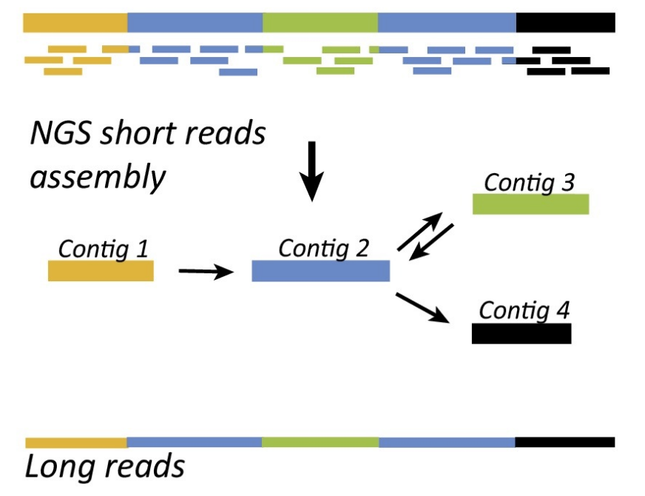
LONG-READS VERSUS SHORT-READS
Assembly of DNA fragments with repeated sequences
NGS short reads assembly
Several contigs incomplete assembly, underestimation of repeats
Long reads assembly

Slide 17
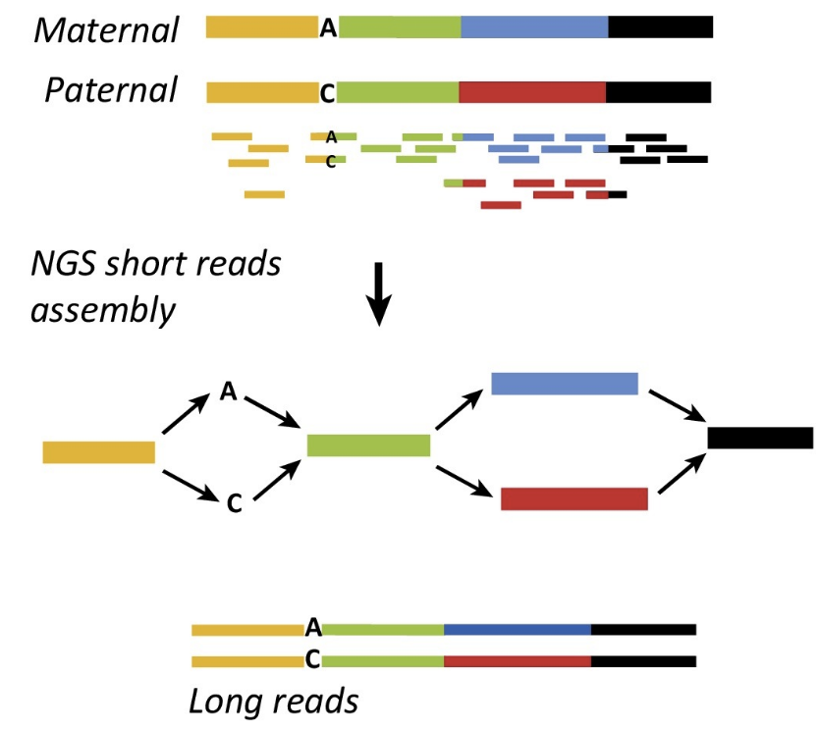
LONG-READS VERSUS SHORT-READS
Haplotype phasing
T
G
T
G
T
G

Slide 18
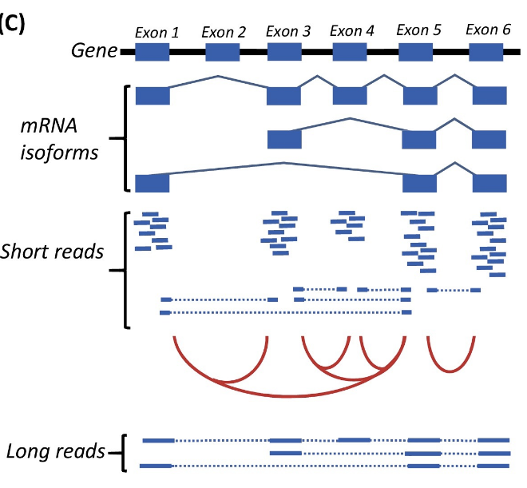
LONG-READS VERSUS SHORT-READS
Detection of splicing isoforms

Slide 19
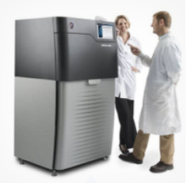
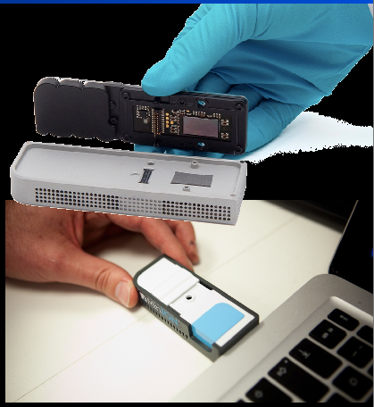
The 3rd generation
winning technologies
Sequel - Pacific Biosciences
Single molecules
Up to 80,000 bp long
Error rate ≈ 10-15 % - CCS: <1%
Compensated by coverage
MinION - Oxford Nanopore
Single molecules
> 200 000 bp long
Error rate ≈ 10-15 %
Compensated by coverage

Slide 20
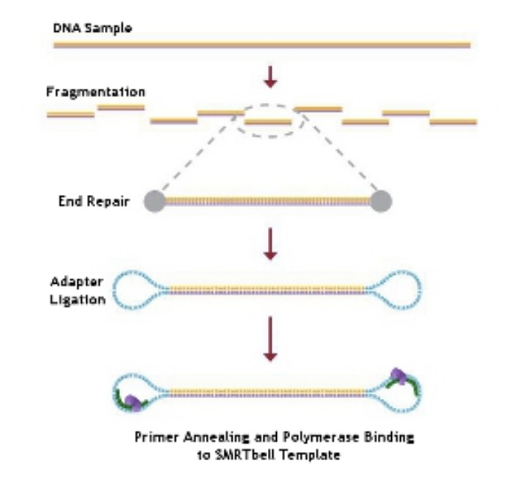
PacBio : Single Molecule Real Time (SMRT) sequencing
PacBio DNA-seq library

Slide 21
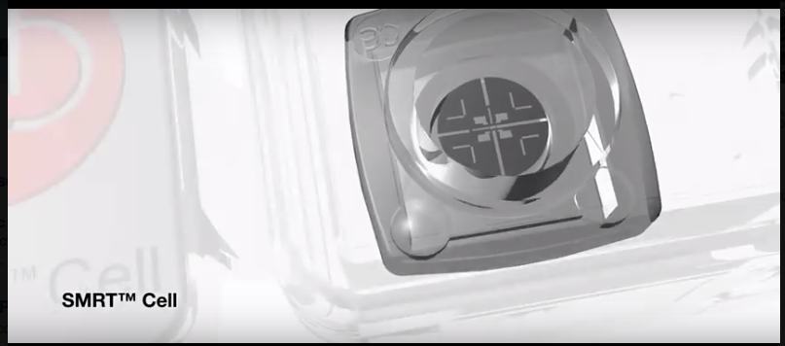
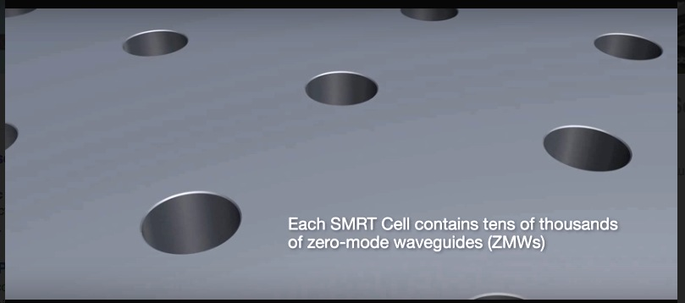

Pacific Biosciences
ZMW

Slide 22
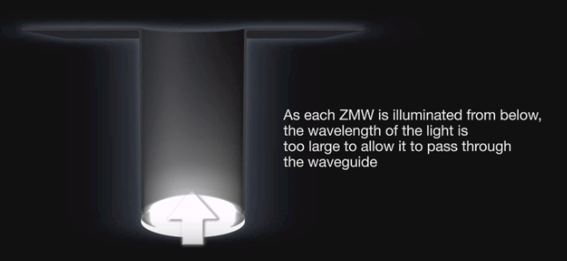
Pacific Biosciences
ZMW : optical waveguide that guides light energy into a volume that is small compared to the wavelength of the light

Slide 23
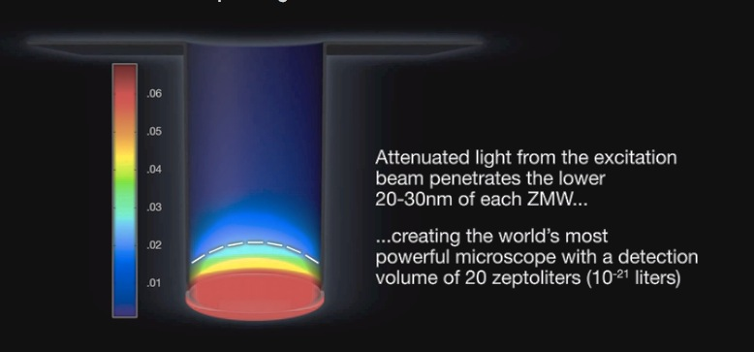
Pacific Biosciences

Slide 24
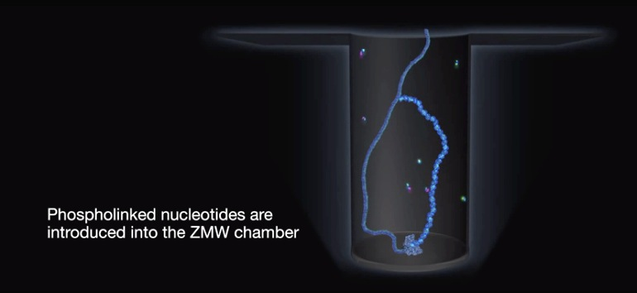
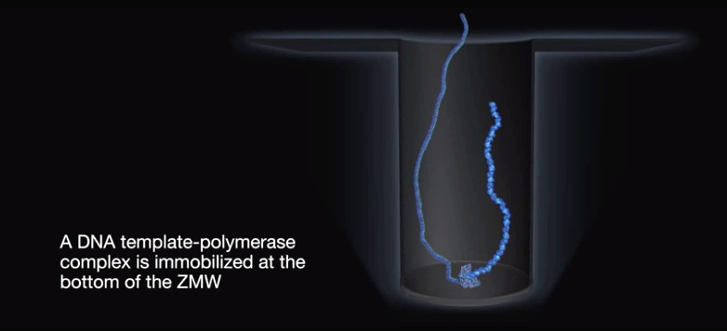
Pacific Biosciences

Slide 25
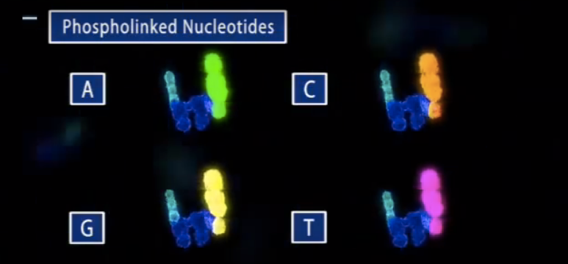
Pacific Biosciences

Slide 26

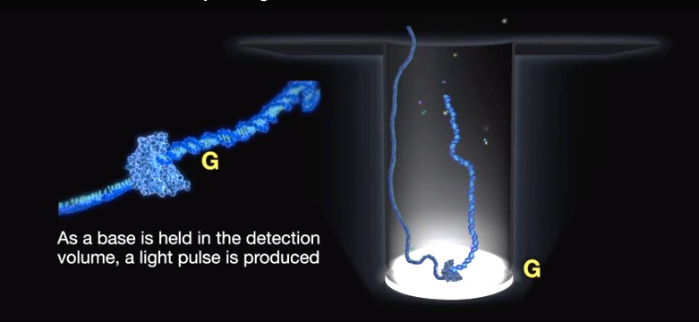

Pacific Biosciences

Slide 27
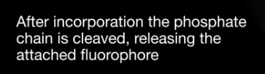
Pacific Biosciences

Slide 28
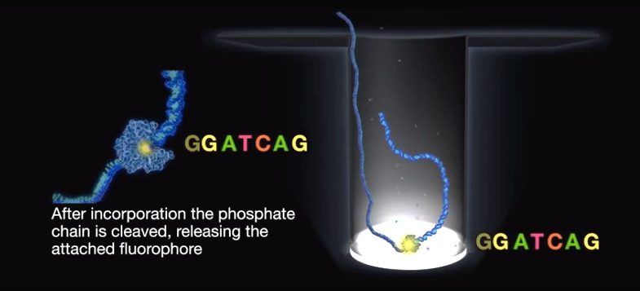
Pacific Biosciences

Slide 29
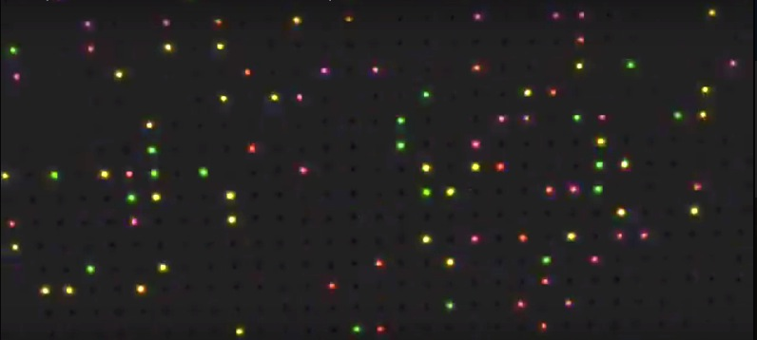

Slide 30
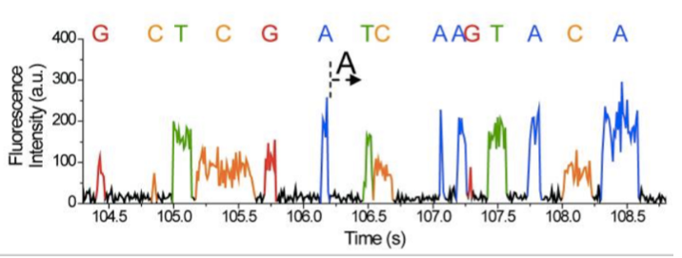

Slide 31
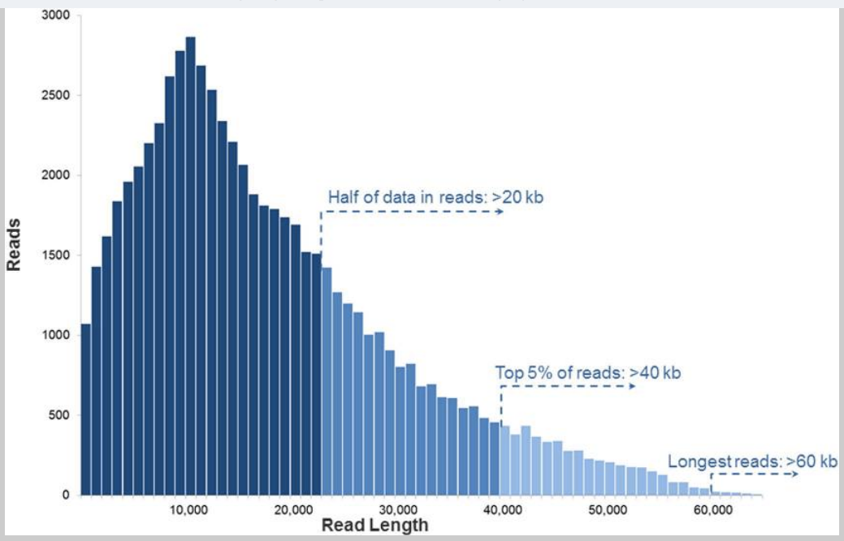
Length of PacBio reads
2015
(Rhoads, Genomics Proteomics Bioinformatics, 2015)
Half of reads > 20 kb
Top 5% of reads > 40 kb
Longest reads > 40 kb

Slide 32
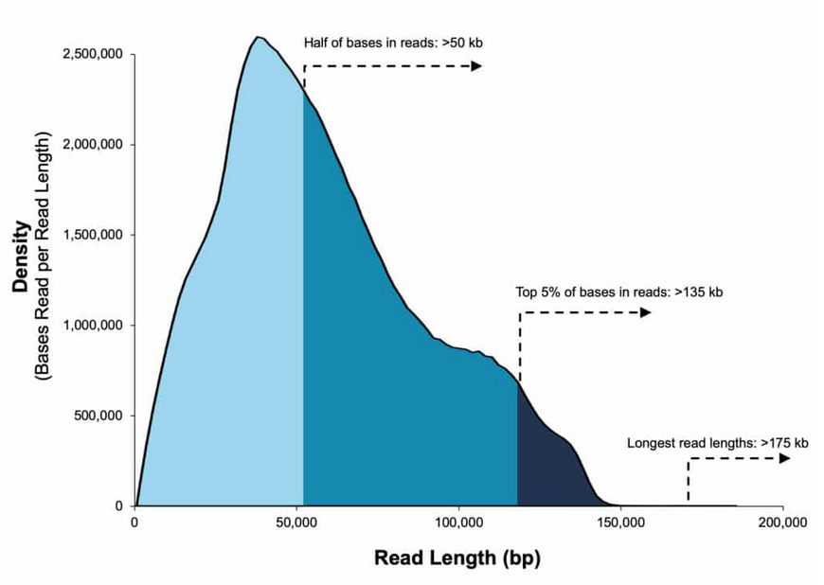
Length of PacBio reads
2015
(Rhoads, Genomics Proteomics Bioinformatics, 2015)
Half of reads > 20 kb
Top 5% of reads > 40 kb
Longest reads > 40 kb
Half of reads > 50 kb
2019
Data from 35 kb size-selected E. coli library
Sequel II System ; 2.0 Chemistry
Top 5% of reads > 135 kb
Longest reads > 175 kb

Slide 33
RECENT IMPROVEMENT WITH NEW CHEMISTRY
Pacific Biosciences
Circular consensus sequencing (CCS) reads are obtained when the SMRT bell template is replicated several times by the polymerase
This allows a highly accurate sequencing by correction of random errors

Slide 34
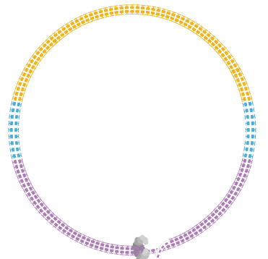
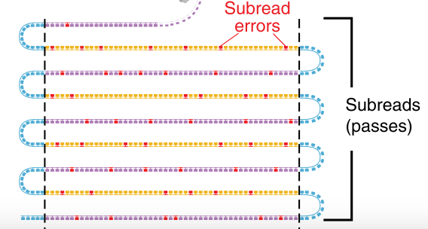
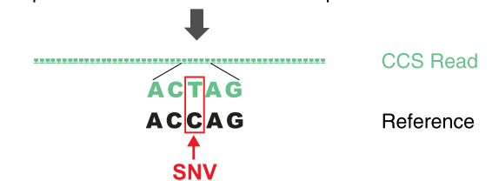
RECENT IMPROVEMENT: GENOME ASSEMBLY WITH CCS

Slide 35
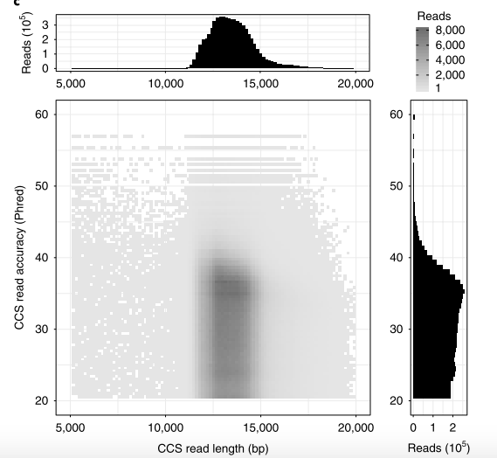
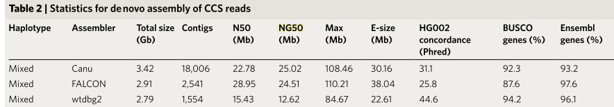
RECENT IMPROVEMENT: GENOME ASSEMBLY WITH CCS
Circular consensus assembly of a human genome
Wenger et al. Nat. Biotechnol. oct. 2019

Slide 36
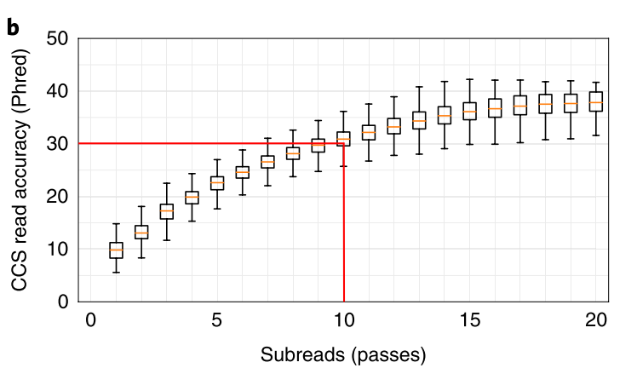
RECENT IMPROVEMENT: GENOME ASSEMBLY WITH CCS
Circular consensus assembly of a human genome
Wenger et al. Nat. Biotechnol. oct. 2019

Slide 37
RECENT IMPROVEMENT: GENOME ASSEMBLY WITH CCS
Circular consensus assembly of a human genome
Wenger et al. Nat. Biotechnol. oct. 2019
Canu assembly : genome size 3.42 Gb larger than the expected haploid human genome
because it resolves some heterozygous alleles into separate contigs
CCS reads alone produced a contiguous and accurate genome with a concordance of 99.997%, substantially outperforming assembly with less-accurate long reads

Slide 38
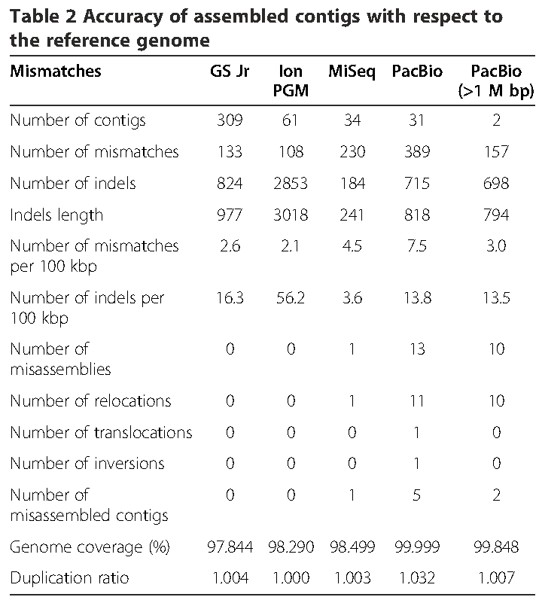

GENOME ASSEMBLY
Miyamoto et al. BMC Genomics 2014
De novo assembly of Vibrio parahaemolyticus (5 Mb): two circular chromosomes

Slide 39

PacBio GENOME ASSEMBLY
De novo Assembly of Two Swedish Genomes Reveals Missing Segments
from the Human Reference (hg38)
Ameur et al. Genes, 2018
10 Mb of the 2 genomes are absent from hg38 reference
1 Mb are assigned to chr. Y
6 Mb are shared with a Chinese personal genome
Inclusion of these sequences in GRCh38 genome radically
improves alignment and variant calling from short-read data :
re-analysis :
yields > 75,000 putative novel single nucleotide variants (SNVs)
removes > 10,000 false positive SNV calls per individual
It becomes possible to represent specific population groups by assembly of representative genomes from different populations.

